Slide 1
Introduction to Machine Learning

Slide 2
Definition
Arthur Samuel:
the study that gives computers the ability to learn without being explicitly programmed
application of Artificial Intelligence
enables systems to learn from vast volumes of data and solve specific problems.
Learning requires data, and ML is used to make predictions on data that has not yet been seen, with a margin of error

Slide 3
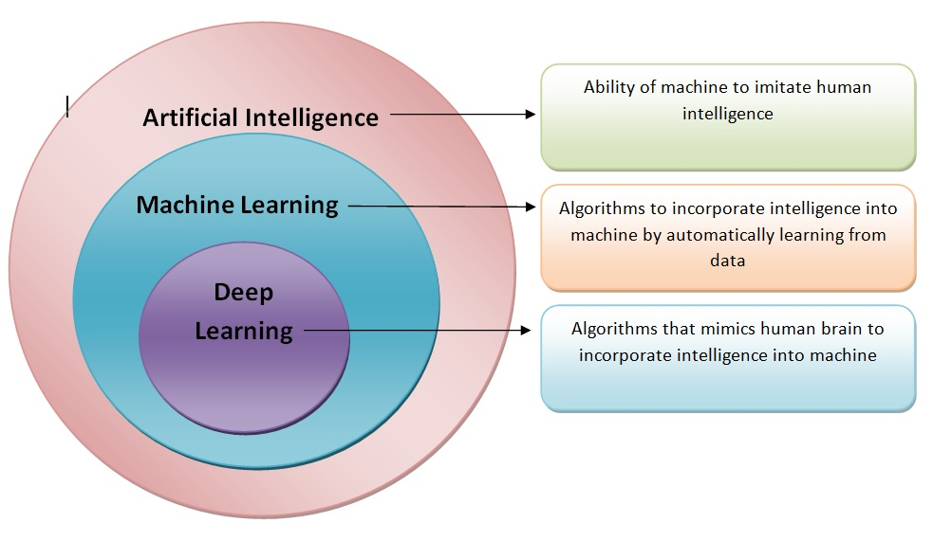
AI VS ML

Slide 4
Machine learning Life Cycle
Problem Definition
Data Collection
Data Preprocessing
Feature Engineering
Model Selection and Training
Model Evaluation and Fine Tuning
Model Deployment
Monitoring and Maintenance

Slide 5
Problem Definition
Understand the problem domain and define the problem you want to solve using machine learning
Clearly state the objectives and success criteria for the ML model

Slide 6
Gathering Data and Labeling
Data Gathering is the first step of the machine learning life cycle
identify the different data sources (database, internet, vendors etc.)
The quantity and quality of the collected data will determine the efficiency of the output
After collection, we need to label the data

Slide 7
Data Preprocessing
Data cleaning
clean the data by imputing missing values,
analyzing wrong-labeled data,
removing outliers
reducing the noise

Slide 8
Feature Engineering
involves feature selection
dealing with imbalanced classes
data augmentation
normalizing and scaling the data

Slide 9
Model Selection and Training
Select model based on the data problem type (classification, regression, clustering, etc.)
Build effective model architecture by doing extensive research
Defining model metrics
Training and validating the model on the training and validation dataset
Experiment with different models and techniques to identify the best performing model

Slide 10
Model Evaluation and Fine Tuning
Test the model on test dataset
Assess the model's performance using evaluation metrics and validation techniques
Finetune hyperparameters and optimize if needed

Slide 11
Model Deployment
Deploy the trained model into a production environment
Integrate the model into applications, systems, or workflows for real-world use

Slide 12
Types of Machine Learning
generally, there are three types of ML techniques
Supervised
Unsupervised
Reinforcement

Slide 13
Supervised Learning
uses labeled data to train machine learning models
The labels in the data help the algorithm to correlate the features
The trained model can then make predictions on new, unlabeled data

Slide 14
There are two types of supervised learning:
Regression
Linear Regression
Regression tree
Non-Linear Regression
Bayesian Linear Regression
Classification
Random Forest
Decision Tree
Logistic Regression
Support Vector Machine

Slide 15
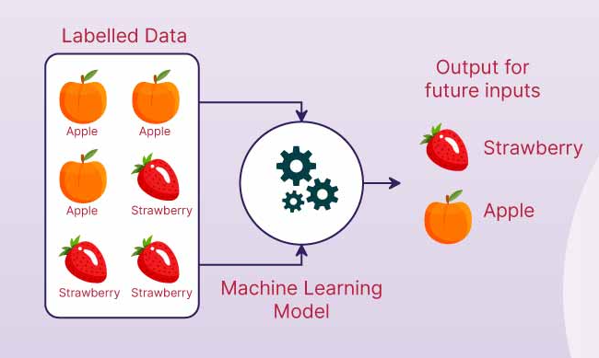

Slide 16
Unsupervised Learning
unsupervised learning algorithms do not work with labeled data
they try to learn the inherent structure/pattern from the input data itself
There are two types of unsupervised learning:
Clustering
K-means clustering, DBSCAN clustering (density based), spatial clustering
2. Association
Apriori Algorithm

Slide 17
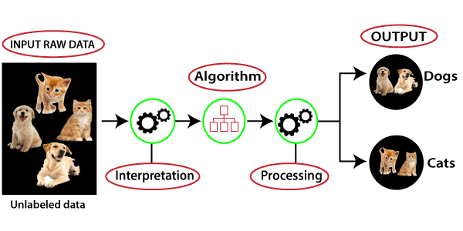

Slide 18
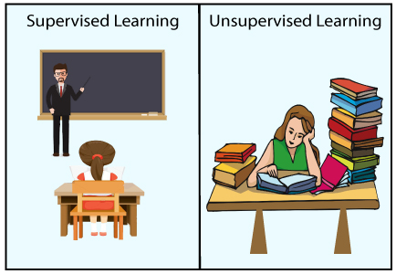

Slide 19
Why need unsupervised learning?
Unsupervised learning is helpful for finding useful insights from the data.
Unsupervised learning is much similar as a human learns to think by their own experiences, which makes it closer to the real AI.
Unsupervised learning works on unlabeled and uncategorized data which make unsupervised learning more important.
In real-world, we do not always have input data with the corresponding output so to solve such cases, we need unsupervised learning.

Slide 20
Reinforcement Learning
Reinforcement Learning is a type of machine learning where an agent learns to make decisions by performing actions in an environment to achieve a goal.
The agent receives rewards or penalties based on its actions.
Can continuously improve model/system with more experience.
Adaptable to new and dynamic environments

Slide 21
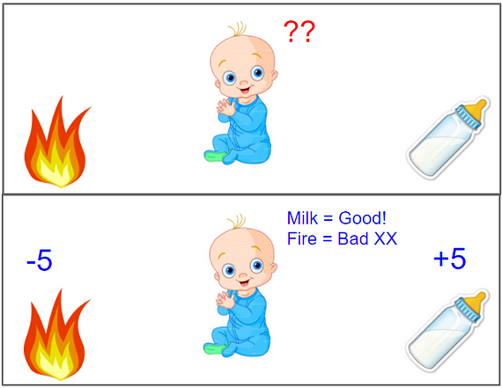

Slide 22
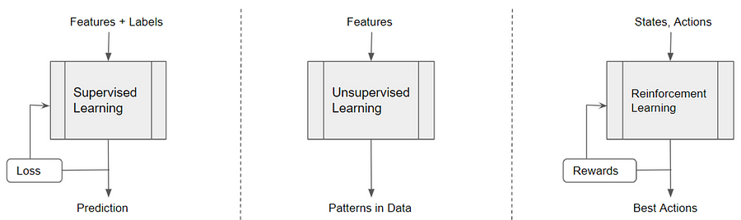

Slide 23
Thank You

